Slide 1
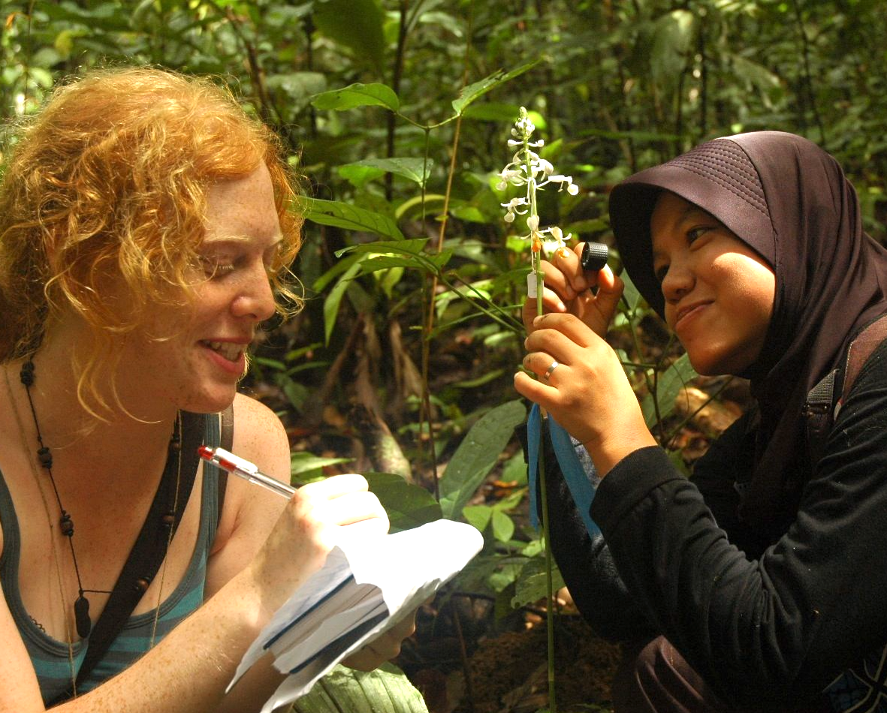
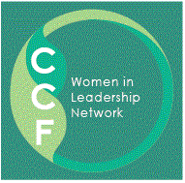
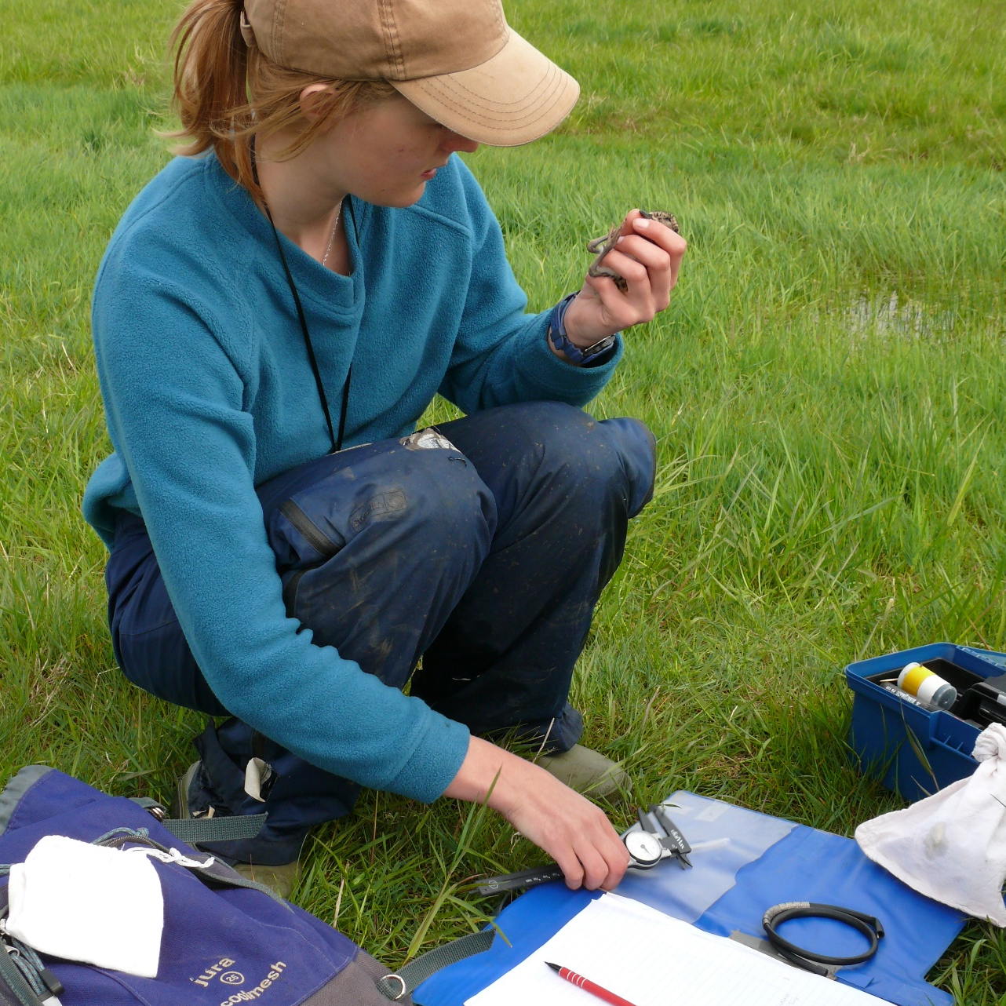
Women in Conservation Leadership Network
Working for gender equality in conservation
OUR VISION
We believe that diversity leads to a stronger conservation community. We strive for leadership that is representative of the many different voices and experiences within our sector.
There is a growing recognition that greater diversity in groups leads to more positive and enduring outcomes across many different fields. Gender equality and representation of women in conservation leadership will result in greater conservation impact.
OUR GOALS
We work to achieve gender equality in conservation – in Cambridge and beyond. Cambridge is a global hub for conservation, our network focuses here and inspires and provides resources globally.
Professional culture that is inclusive – with women’s voices heard
Broader interpretation of leadership – that recognises differences
Progression and promotion strategies that work for women
Women equipped with leadership skills
Women positive and confident in progressing their careers
OUR ACTIONS We seek funding to develop and expand all of these activities
Catalyse action to achieve equality within the conservation community
Empower and equip women to achieve their potential and aspirations
Encourage adoption and inspire commitment to gender equality in conservation organisations. For example:
Routine equality assessment
Increased awareness of unconscious bias
Bias-free recruitment
Diverse, gender-balanced panels and speakers
These elements could be combined into a charter of good practice for conservation organisations.
Run events to inspire action and equip women for leadership. For example:
1. Networking and informal support
2. Training and leadership skills
3. Education and awareness raising for all genders
4. Highlighting International Women’s Day and similar events
We aim to grow our global online community and facilitate ongoing dialogue and support.
Photo credits: Tropical Biology Association and members of the network

